Slide 1
Statistical Analysis of Comparative Experiments based on Large Strip On-farm Trials
Presented by: Jordan Brown and Andrew Grose;
K. Stefanova, J. Brown, A. Grose, Z. Cao, K. Chen, M. Gibberd, and S. Rakshit.
Notes:
This presentation forms part of a submitted research paper looking at statistical analysis of large strip trials aimed at comparative experiments.
Jordan and I will each detail similar methodology both aimed at analysing data from on-farm experimentation using linear mixed models and in particular, ASReml.

Slide 2
Outline
Introduction to the problem
The dataset
Regular Grid partitioning
Two-step clustering
Notes:
The structure of the presentation will follow with a brief introduction to the problem where we summarise the main aims of the proposed methodology. This will be followed then by an overview of the data which is used as a motivating example.
Then we will go into more detail regarding two approaches; that is the regular-grid partitioning which will be demonstrated by myself, as well as the two-step clustering approach which will be covered by Jordan.

Slide 3
Introduction to the Problem
Analyse data obtained from a large strip trial with qualitative treatments.
Demonstrate whether the treatment effect varies spatially or not?
If so, explain why it may be varying?
Farmer recommendation for their entire paddock
An understanding of the performance of each treatment.
Geographically weighted regression (GWR):
handles quantitative treatments; optimum treatment map. (Rakshit et al. 2020)
Randomised vs systematic? (Piepho et al. 2011)
Notes:
The main aim here is to analyse large strip trials where the treatments are categorical. Our goal is to be able to demonstrate to farmers whether the treatment effect varies or not. Should this treatment effect vary spatially, then the secondary goal is to try to explain why it may be varying. Ultimately, we want to give farmers a recommendation for their entire paddock, but also give them an understanding of the performance of each treatment.
This leads us to established methodology such as Geographically Weighted Regression (GWR) which in recent literature, has been applied to on-farm experimentation in a number of ways. GWR can be especially effective at producing optimum treatment maps for a given set of quantitative treatments such as in Rakshit et al. You will find that we demonstrate our results from the proposed methodology in a similar manner. Now in the case of GWR, a systematic design in most instances can be beneficial in producing an optimal prescription map. This leads to the question of whether or not the design should be randomised or systematic? However that is a story for another time.

Slide 4
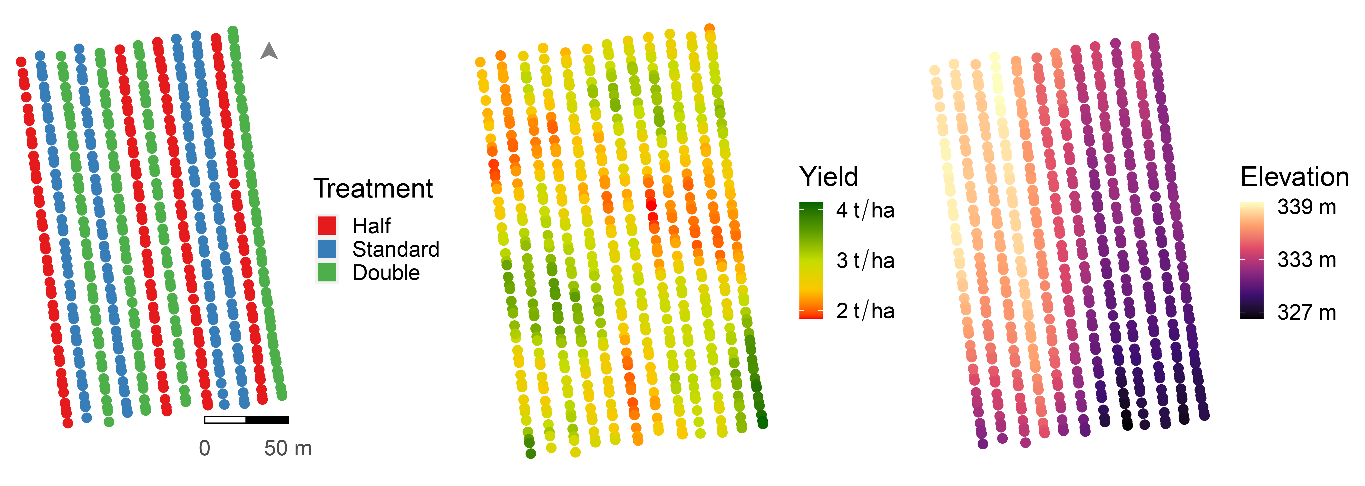
The Dataset: Wagin
3 Phosphorous levels randomised across 4 replicates i.e. 12 strips
The Phosphorous levels were referred to as half, standard and double; the recommended rate.
This trial covered approx. 3 hectares.
Notes:
We demonstrate our methodology on a motivating example taken from one of five on-farm experiments looking at phosphorous application.
There are three treatments; representing half, standard or double - the recommended rate.
Each of these treatments were randomised across 4 replicates equaling 12 strips in total.
This particular trial in-particular covered approximately 3 hectares.

Slide 5
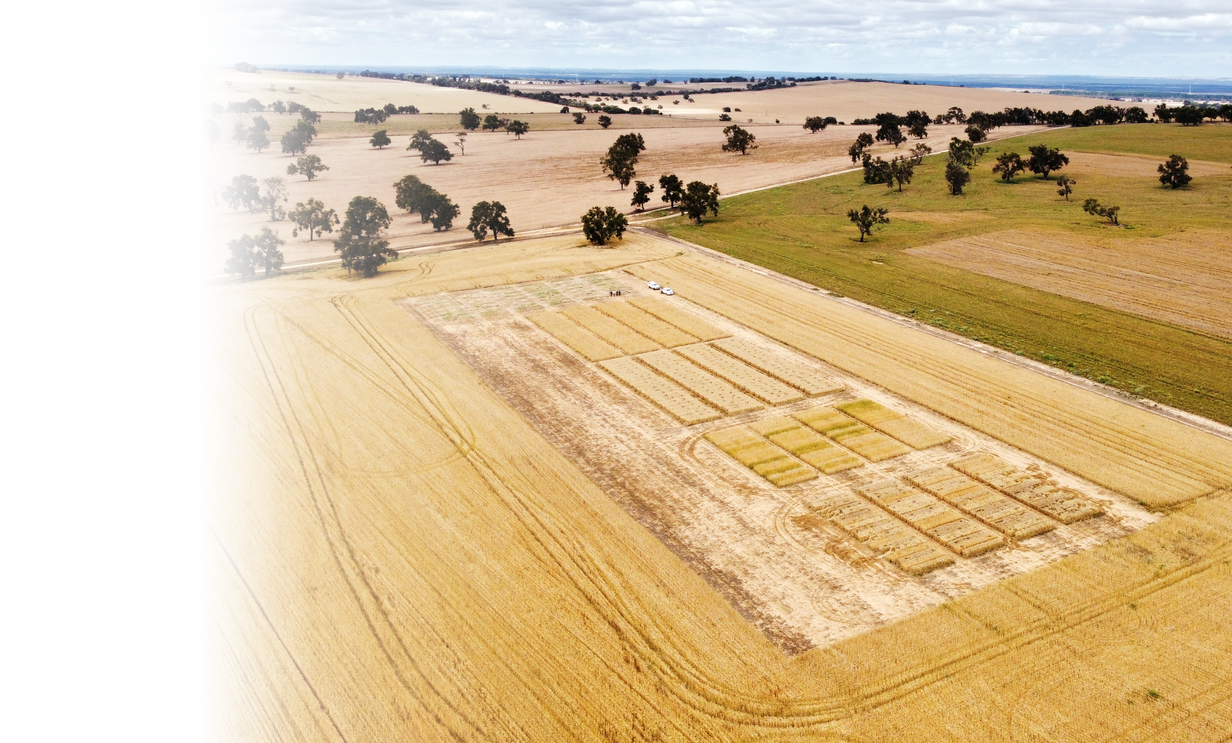
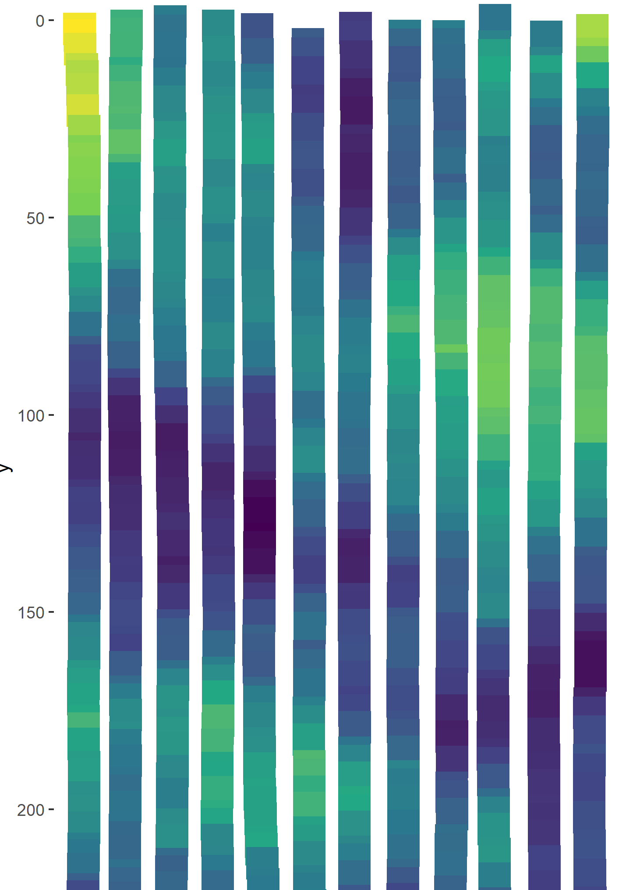
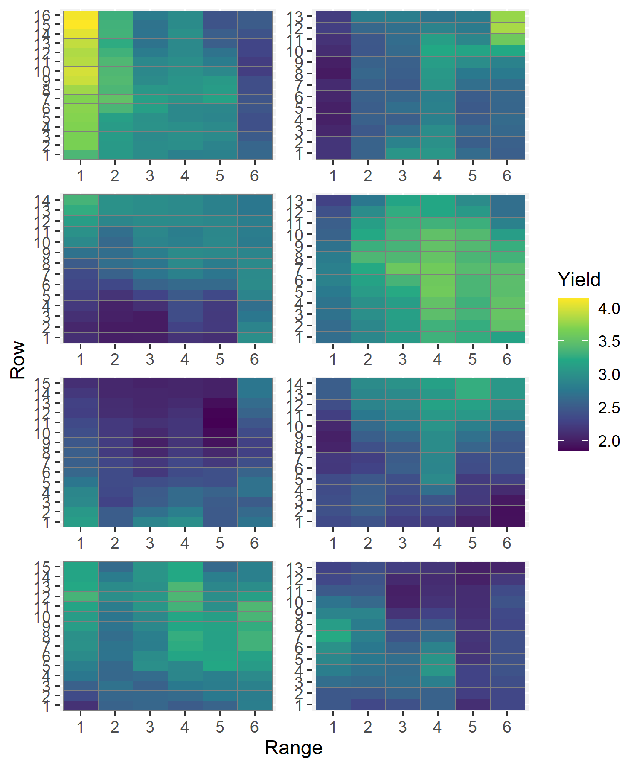
Method 1: Regular Management Blocks
Large plot trials are more susceptible to greater spatial variability.
Defining "management blocks" aims to rectify this.
Different configurations were explored within the paper.
These management blocks were accounted for in the LMM.
Notes:
It is reasonable to assume that large-strip trials are more susceptible to greater spatial variability given the sheer size of the trial compared to traditional small-plot trials.
Therefore, by partitioning the trial into homogenous areas or, what we can refer to as, management blocks, allows for lesser spatial variability within each block. We explore this idea in a number of configurations to demonstrate whether there may be an “optimal” configuration that best describes the spatially varying treatment effect.
In terms of the modelling component of the linear mixed model, these management blocks were appropriately accounted for.
We will now demonstrate how we go about partitioning the data which is originally expressed as spatial points to a “regular grid”.

Slide 6
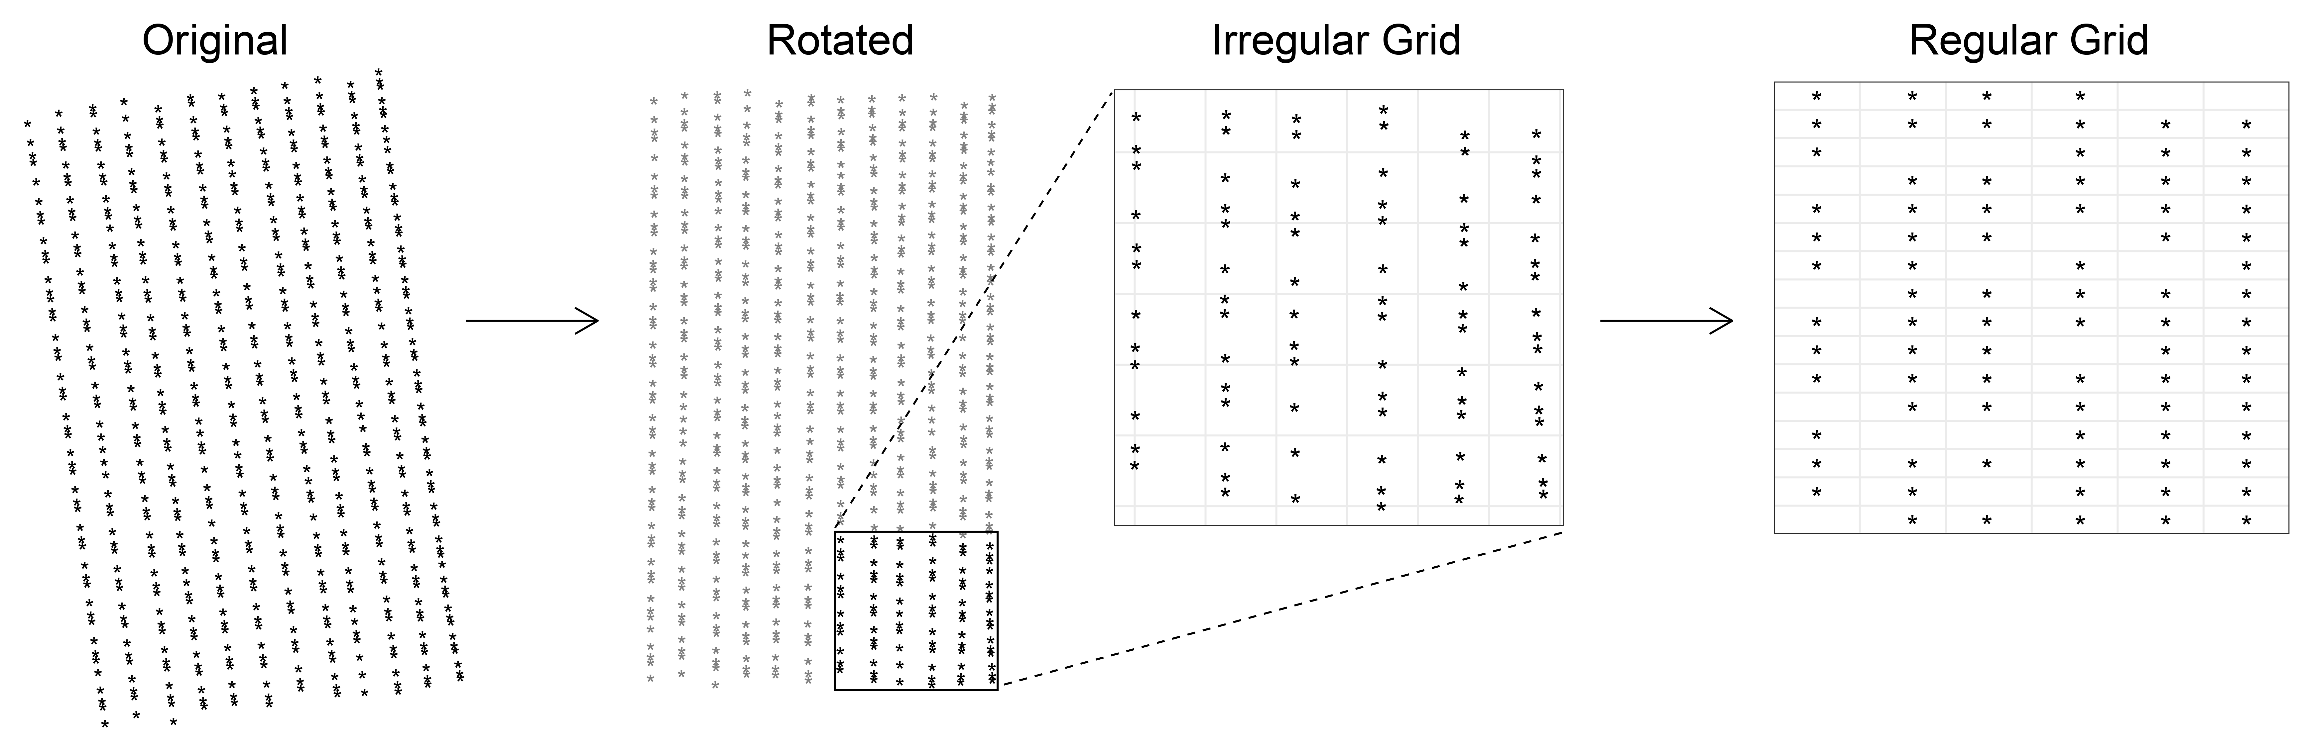
Formation of Regular Grid
Traditionally, small plot field trials follow a grid whereby plots are spread across rows/ranges.
LMM techniques and diagnostics are inherently designed around the idea that the data follows this "regular grid".
For e.g spatial autocorrelation models (Gilmour et al. 1997; Stefanova et al. 2009)
It may be useful to convert spatial data (such as those retrieved from a yield monitor) to an evenly-spaced grid.
Notes:
Traditionally, most small-plot field trials are designed in a way in which plots are spread across rows and/or ranges. As a result a lot of the techniques, in-particular using linear mixed models, that are inherently designed around the idea that the data follows this ``grid".
In small plot trials its common to fit separable first order autoregressive processes to the variance structure of the plot errors. This, combined with diagnostics such as the sample variogram, along with the use of an appropriate polynomial term assists in accounting for local trend.
For example, the yield monitor data here, records data in 2 second intervals. In a sense we can think of the autoregressive component of the model capturing the regular time intervals as opposed to just space.
It may be useful to convert spatial data (such as this) to an evenly spaced grid in order to use such techniques.

Slide 7
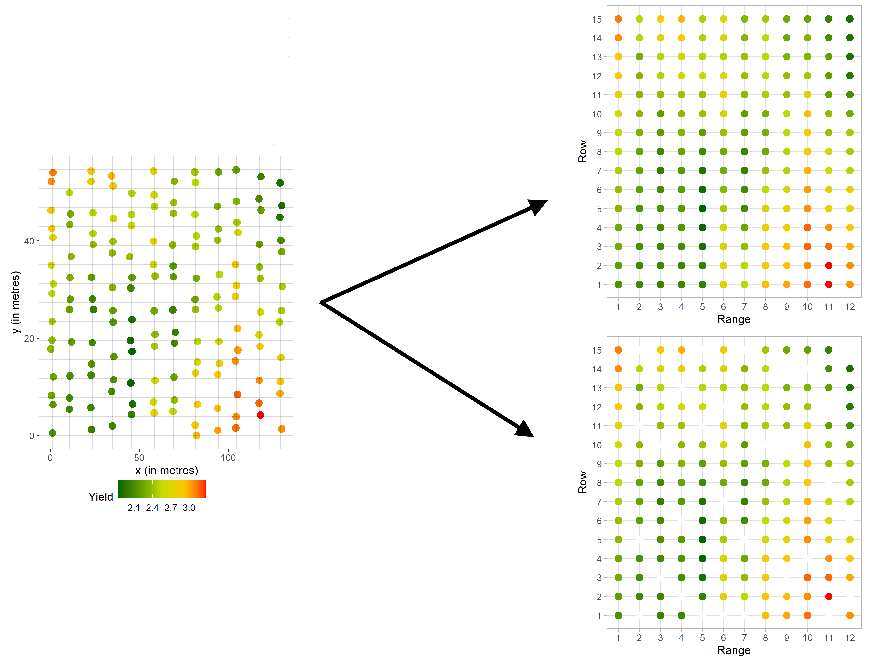
Nearest Neighbour Griding
Notes:
In order to translate it into a regular grid we use nearest neighbour gridding.
This can be done in either of two ways; with and without interpolation.
In order to limit the influence of the griding process on the final results we chose to do it without any imputation or interpolation.

Slide 8
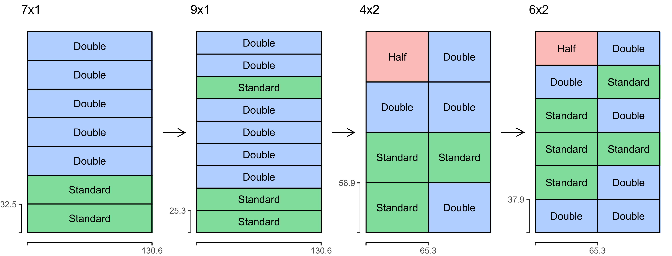
Prediction at Wagin
Notes:
This is an example of the results achieved using different configurations for the dataset from Wagin.
In our motivating examples, we looked at configurations with either one or two columns given the restraints of replications being only four.
In particular, we used the Mean Predicted Error Variance as a possible measure of whether a configuration may be best suited for a given dataset. We also used AIC and BIC.
We found that there exists an ideal range; too few management blocks do not adequately capture the spatial variation in treatment effect. Too many management blocks opens the possibility for overfitting and unreliable estimates.

Slide 9
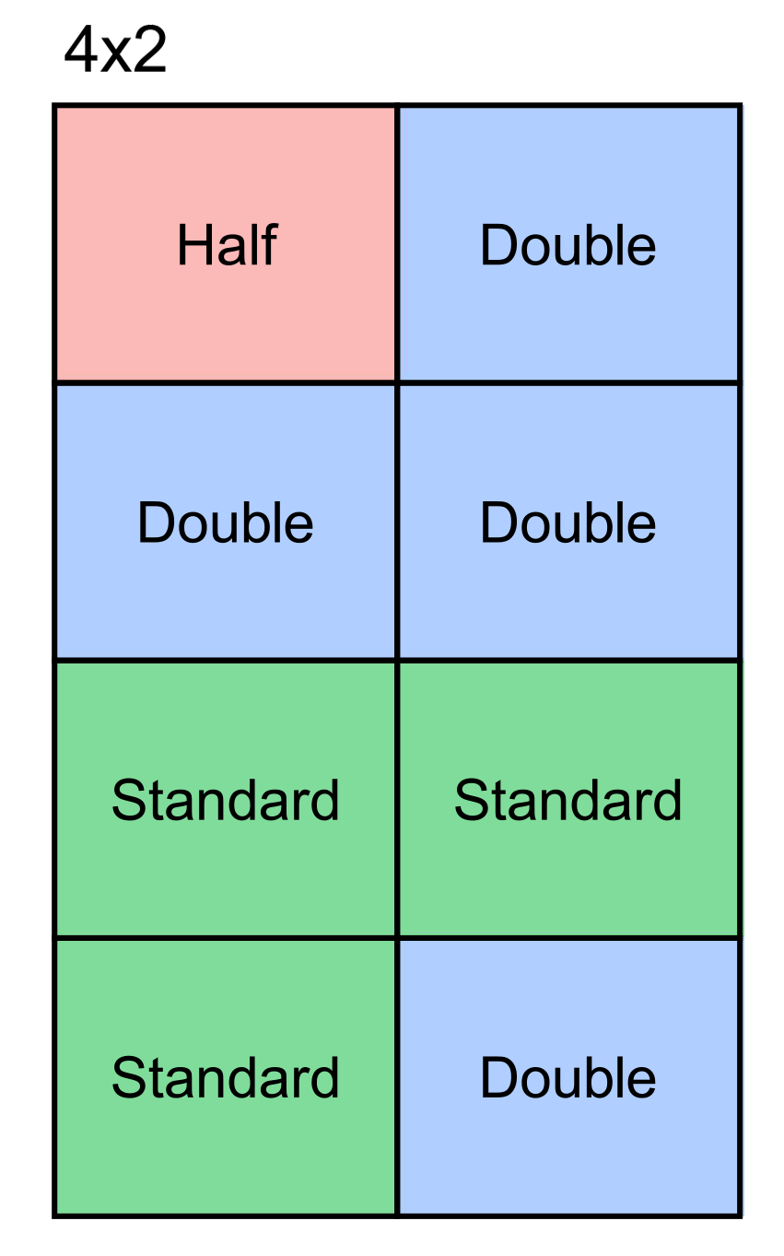
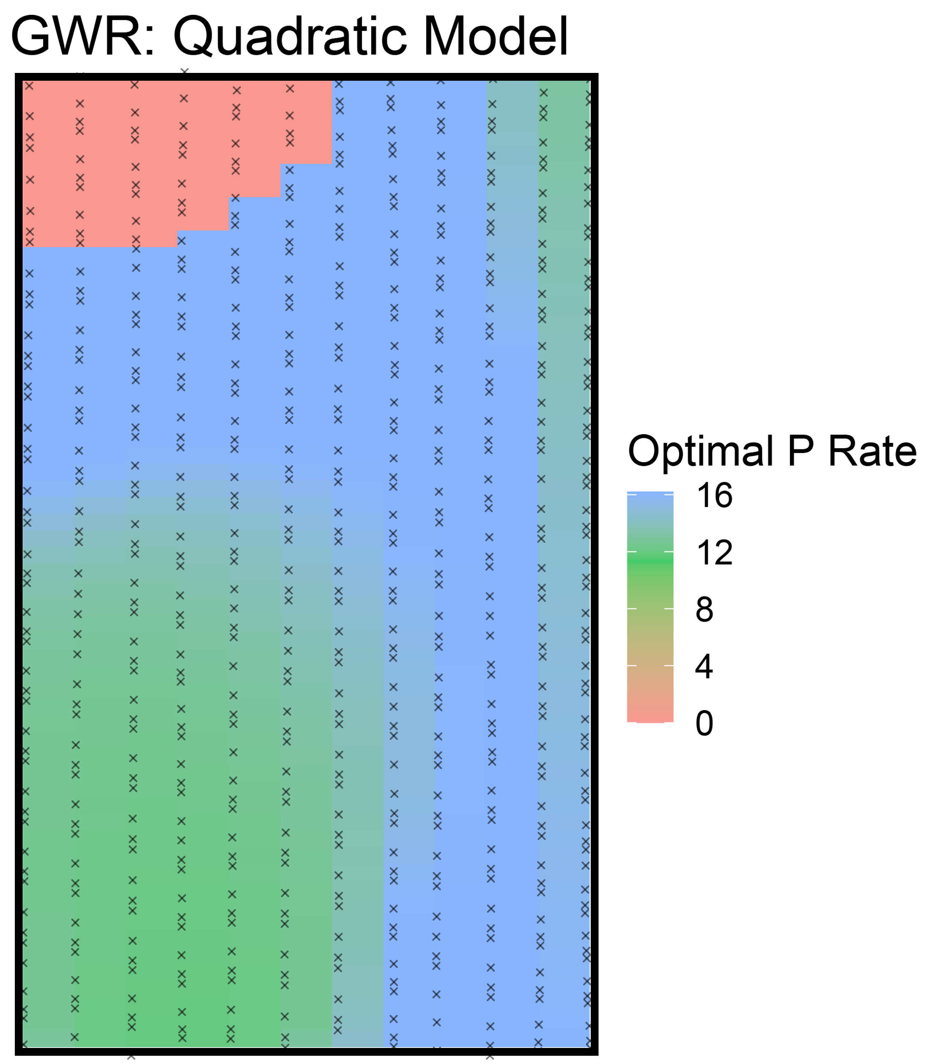
Comparison to GWR - quantitative
Notes:
I have also chosen to include here an example of the results of a GWR quadratic model where the phosphorous rates are quantitative.
This was an interesting result considering the optimal P rate for the Yield is similar to our methodology in which it is treated as categorical.
In the next few slides Jordan will introduce a modification to this methodology where we ultimately look at optimal rates for yield (t/ha) as well as profit ($/ha).

Slide 10
Method 2: Clustering
Used the PAM (Partition Around Mediods) to cluster the environment into Management Blocks based on relevant covariates and blocking information (Rep).
A Two-Step variation (Schuster et al., 2011) was used which led to the management blocks being more contiguous
Elevation was used since this has been shown in other data sets (such as Las Rosas) to be a driver of varying treatment effects.
The number of Management Blocks to use was selected based on the optimality criterion for PAM, which is the average silhouette width.
According to the optimality criterion, an optimal number of Management Blocks was selected, and an analysis was performed considering spatial covariance structures
Notes:
Thanks for covering that andrew. I will now talk about the area that I spent more time on with the paper.
- Clustering was used as it accounts for the potential drivers for changes in treatment effects, and therefore groups the regions according to this.
- This therefore

Slide 11
Wagin Data: A Refresher
Notes:
- Display the data to refresh you on what the terms are
- Hopefully you can observe that there is a some clustering of the yield, as well as a gradient related to the elevation
- We used both of these variables in the two-step clustering algorithm

Slide 12
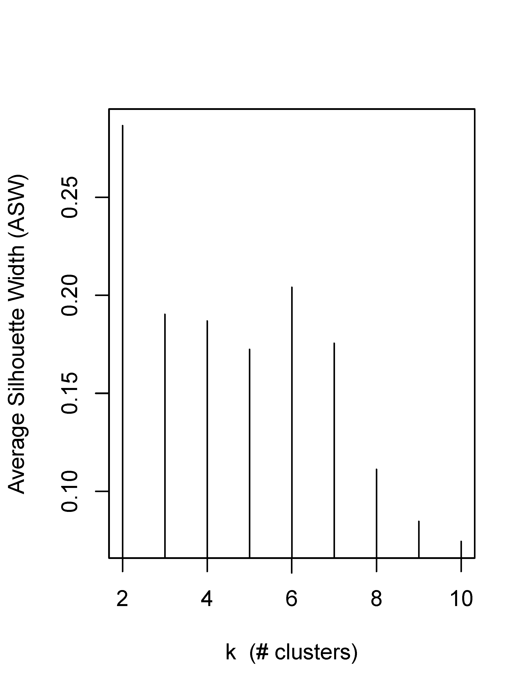
Average Silhouette Width
2 Management Blocks was found to be optimal
However, this didn't provide the desired level of information. Therefore, 6 clusters was decided to be used.
Notes:
- The average silhouette width showed that the best two management blocks configurations were for 2 and 6 management blocks.
- We decided to use 6 since this gave more information about the change of the treatment effect across the field.

Slide 13
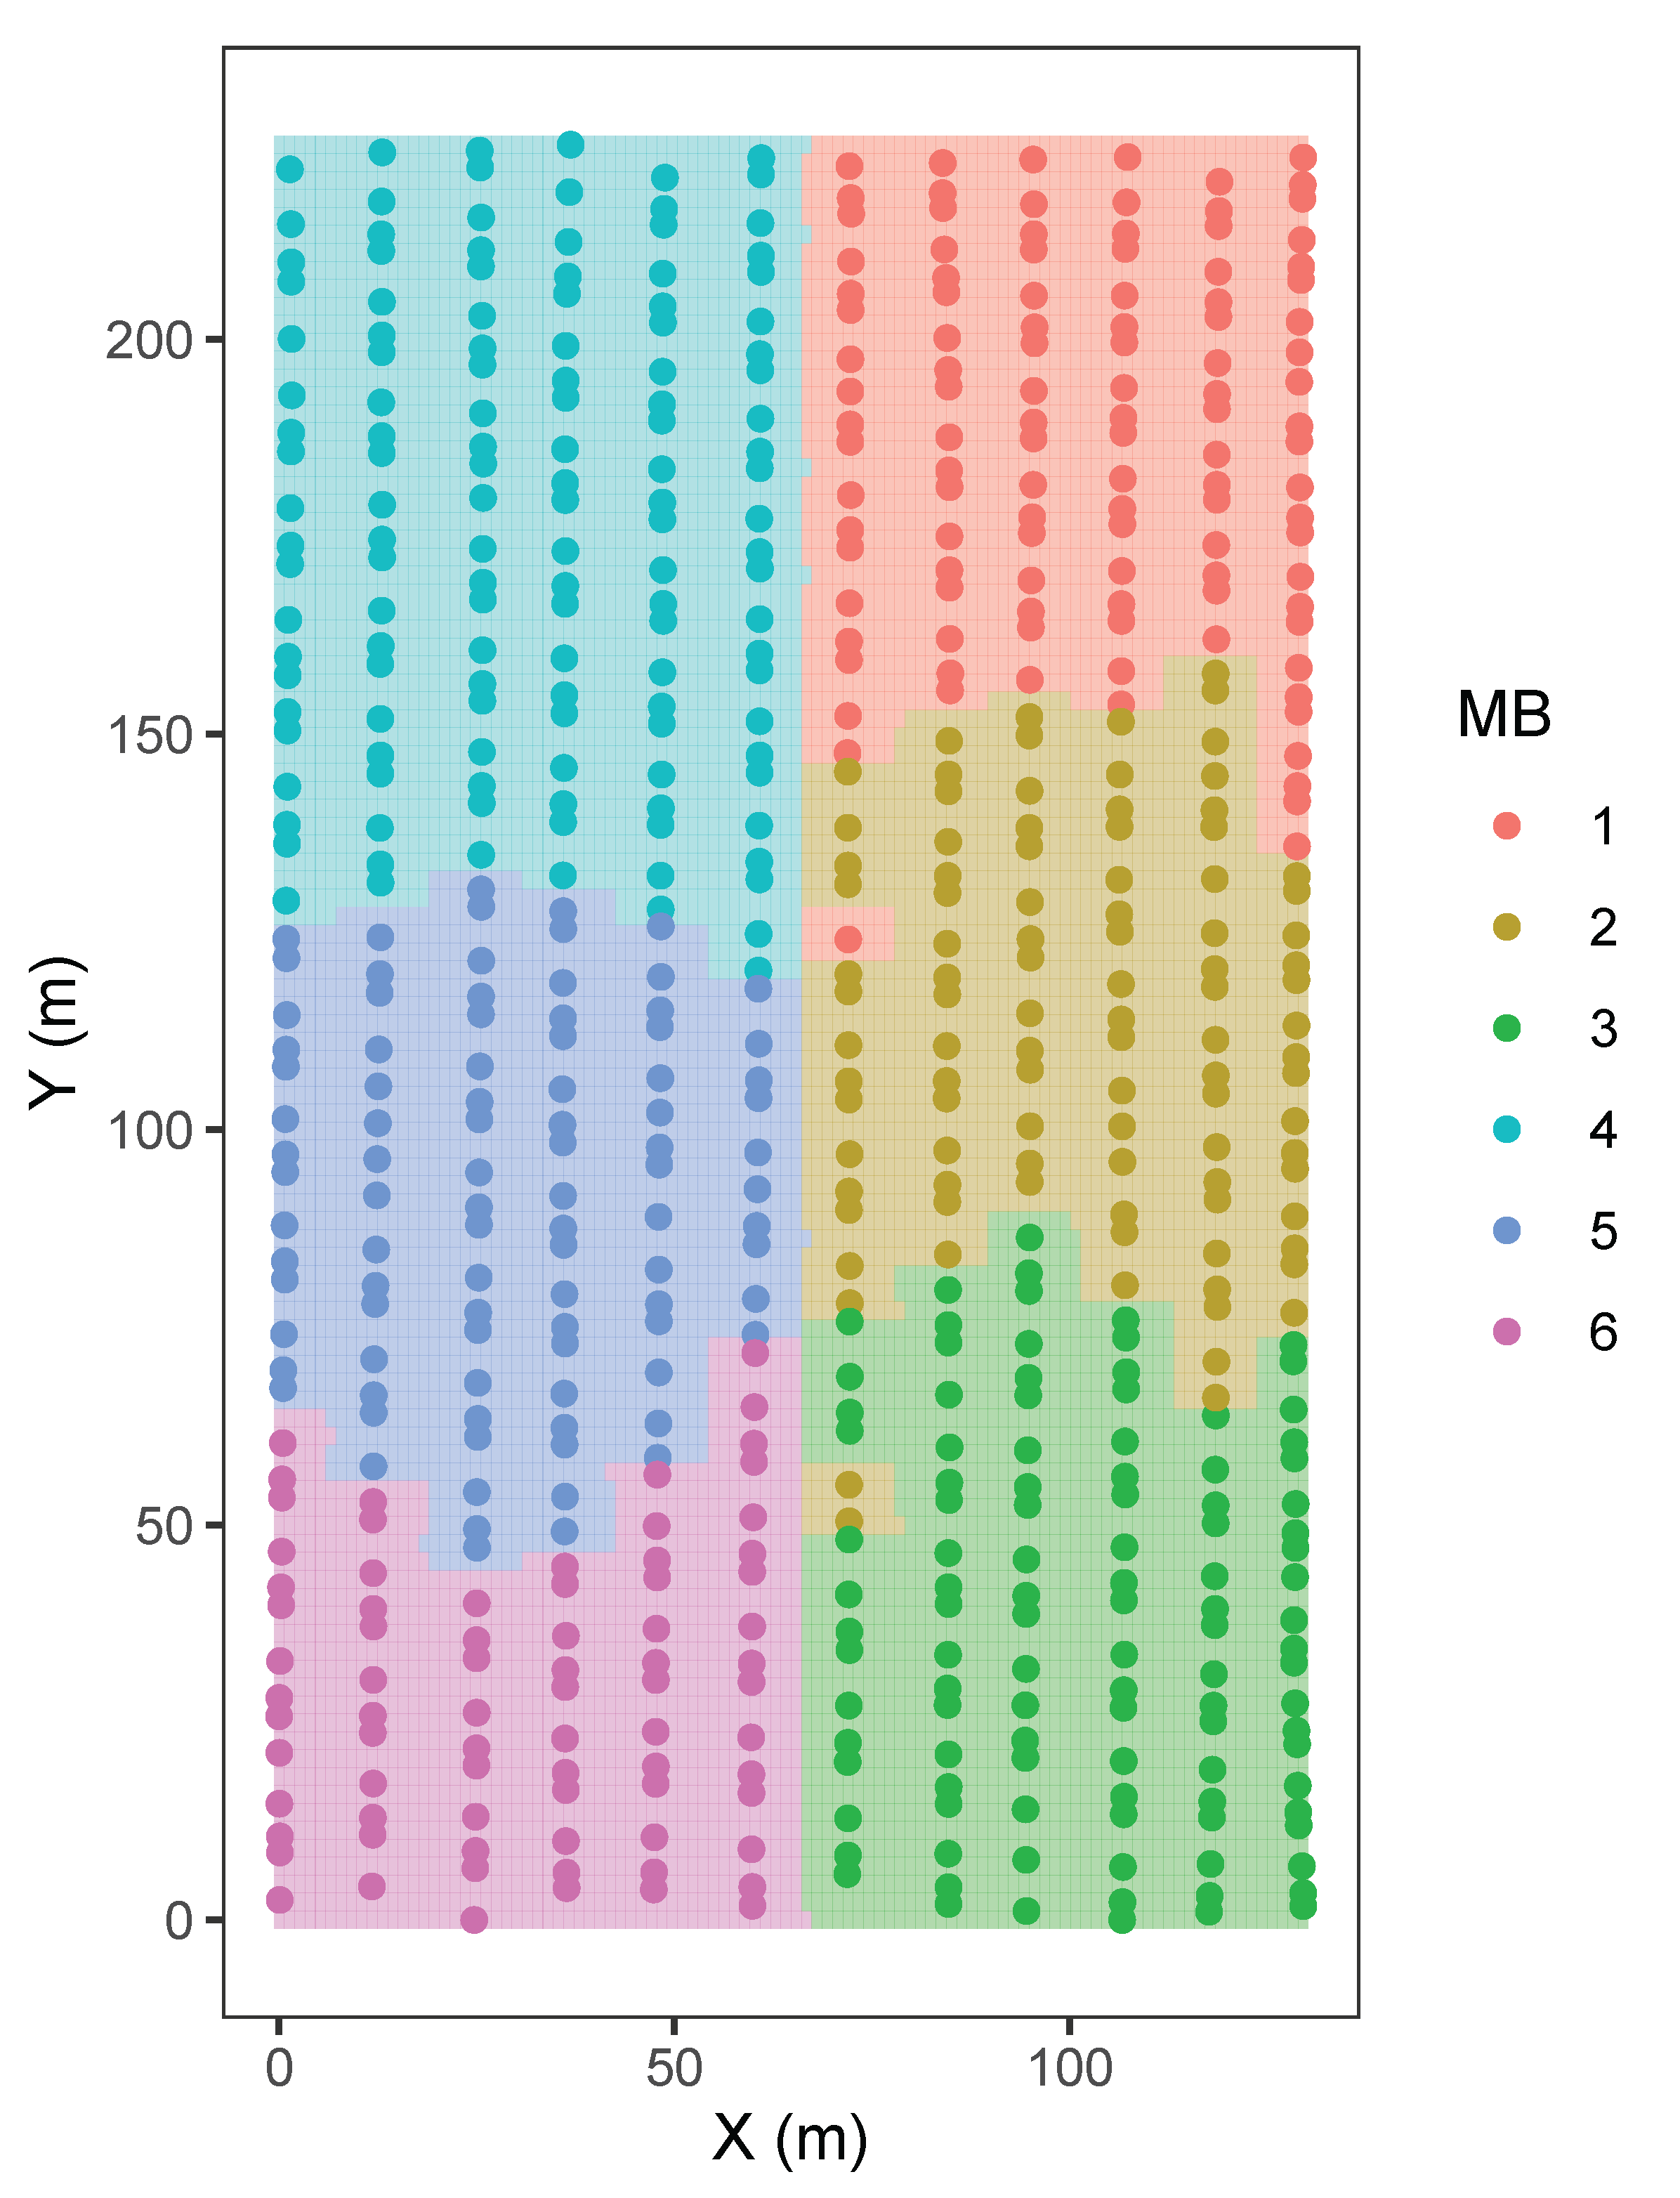
Clustering Results at Wagin

Slide 14
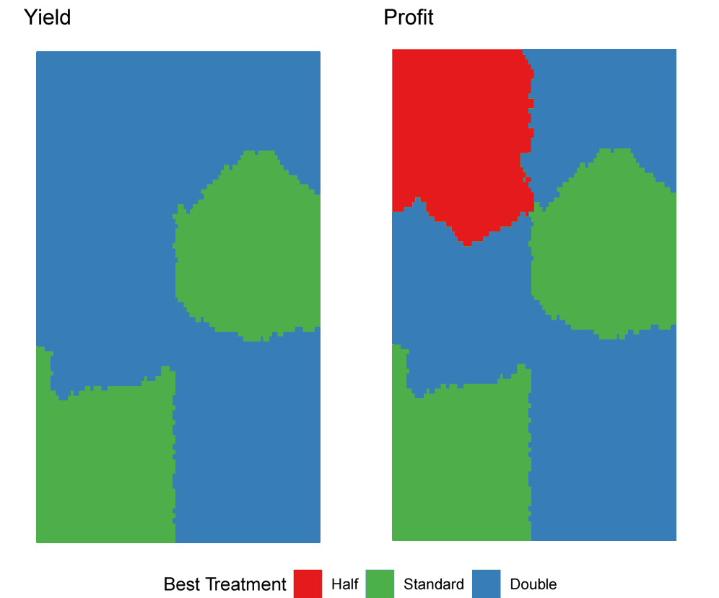
Prediction and Profit at Wagin
Notes:
This shows the best treatment for yield and profit across wagin.

Slide 15
Model Fitting structure
The model fitted had the following structure:
Fixed: ~ MB
Random: ~ diag(MB):Treatment
Residual: ~ dsum( ~ agau(X,Y)|MB). Other spatial covariance structures were also considered such as aexp and mtrn. If neither of these fit well, then we could consider using id.
Notes:
We decided on fitting the following model:
- For the fixed term, we have SubEnv
- For the random term, we have diag(SubEnv):Treatment. The replicate effect was not included since
- For the Residual term, we have ~ dsum( ~ agau(X, Y)|SubEnv)

Slide 16
Clustering Methodology: Considerations
The selection of which spatial covariates to cluster on is critical
Using spatial covariates that are not correlated with the treatment effect may lead to incorrect results
Choosing the number of clusters as well is very important. Using the number of clusters based on the optimality criterion does work well to an extent. However, as shown for Wagin, sometimes using the suboptimal number of clusters can reveal different patterns in the data.
Notes:
Selecting the Spatial Covariates is obviously very important for this methodology. They should be selected based on the knowledge of how those covariates may effect the treatment effects. For example, in this case we want to find the covariates that cause phosphorous application to different effects for the different levels.

Slide 17
Conclusion: What we Achieved with the Paper
A new framework to analyse comparative OFEs.
Two partitioning approaches to create the management blocks.
Two step k-Medoids clustering approach used with blocking constraints.
Regular grid method which is effective to provide a site-wide summary
A systematic scheme to convert irregular grid data into regular grid data.
Assessment of the optimal treatment from the economic point of view.
Application of the proposed approach on two large strip OFEs.
Notes:
In conclusion, our paper has achieved the following outcomes:

Slide 18
Thank you for your attention!

Slide 19
References
Gilmour, A. R., Cullis, B. R., & Verbyla, A. P. (1997). Accounting for natural and extraneous variation in the analysis of field experiments. Journal of Agricultural, Biological, and Environmental Statistics, 269-293.
Piepho, H. P., Richter, C., Spilke, J., Hartung, K., Kunick, A., & Thöle, H. (2011). Statistical aspects of on-farm experimentation. Crop and Pasture Science, 62(9), 721-735.
Rakshit, S., Baddeley, A., Stefanova, K., Reeves, K., Chen, K., Cao, Z. & Gibberd, M. (2020). Novel approach to the analysis of spatially-varying treatment effects in on-farm experiments. Field Crops Research, 255, 107783.
Stefanova, K. T., Smith, A. B., & Cullis, B. R. (2009). Enhanced diagnostics for the spatial analysis of field trials. Journal of agricultural, biological, and environmental statistics, 14(4), 392-410.

